Slide 1


Slide 2


Slide 3
Azure DevOps for Agencies
Automation of the Entire Ecosystem

Slide 4
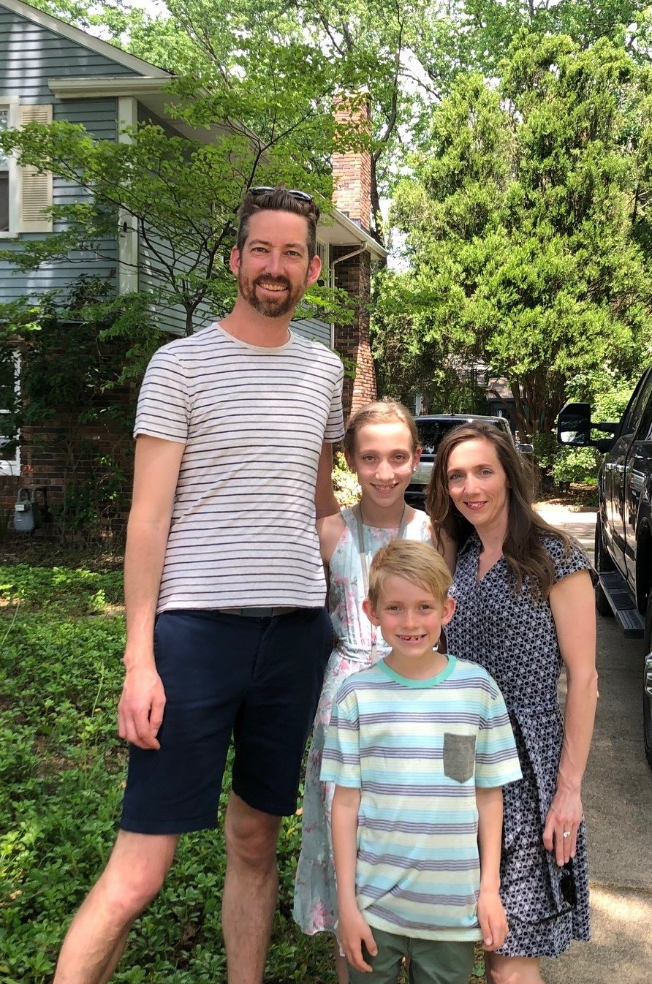

Introduction
CTO at Aztek a web design, development and marketing agency in Cleveland, Ohio
Former .NET dev turned ops
6’7 ¾”
No, I don’t play basketball

Slide 5
Why is DevOps different for Agencies?
Churn and Burn
Low traffic volume solutions
Junior devs
Automation
Scalability

Slide 6
Goal
Create DEV, UAT, PROD websites
Follow best practices
Library
Flexibility

Slide 7
End-to-End Solution
Great documentation, however, need something more complete and fits my needs
Assumptions – Compute Setup – DEV, UAT, PROD
Windows Server 2022
Plain webservers with SQL installed
.NET 5 and .NET Framework Examples

Slide 8
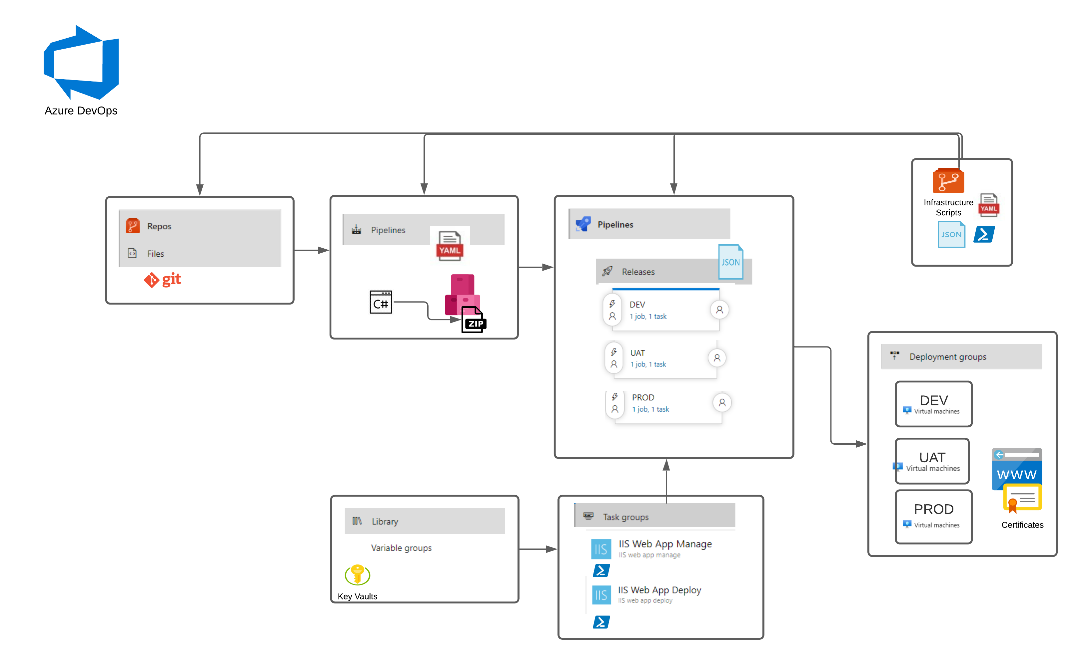
End-to-End-Solution

Slide 9
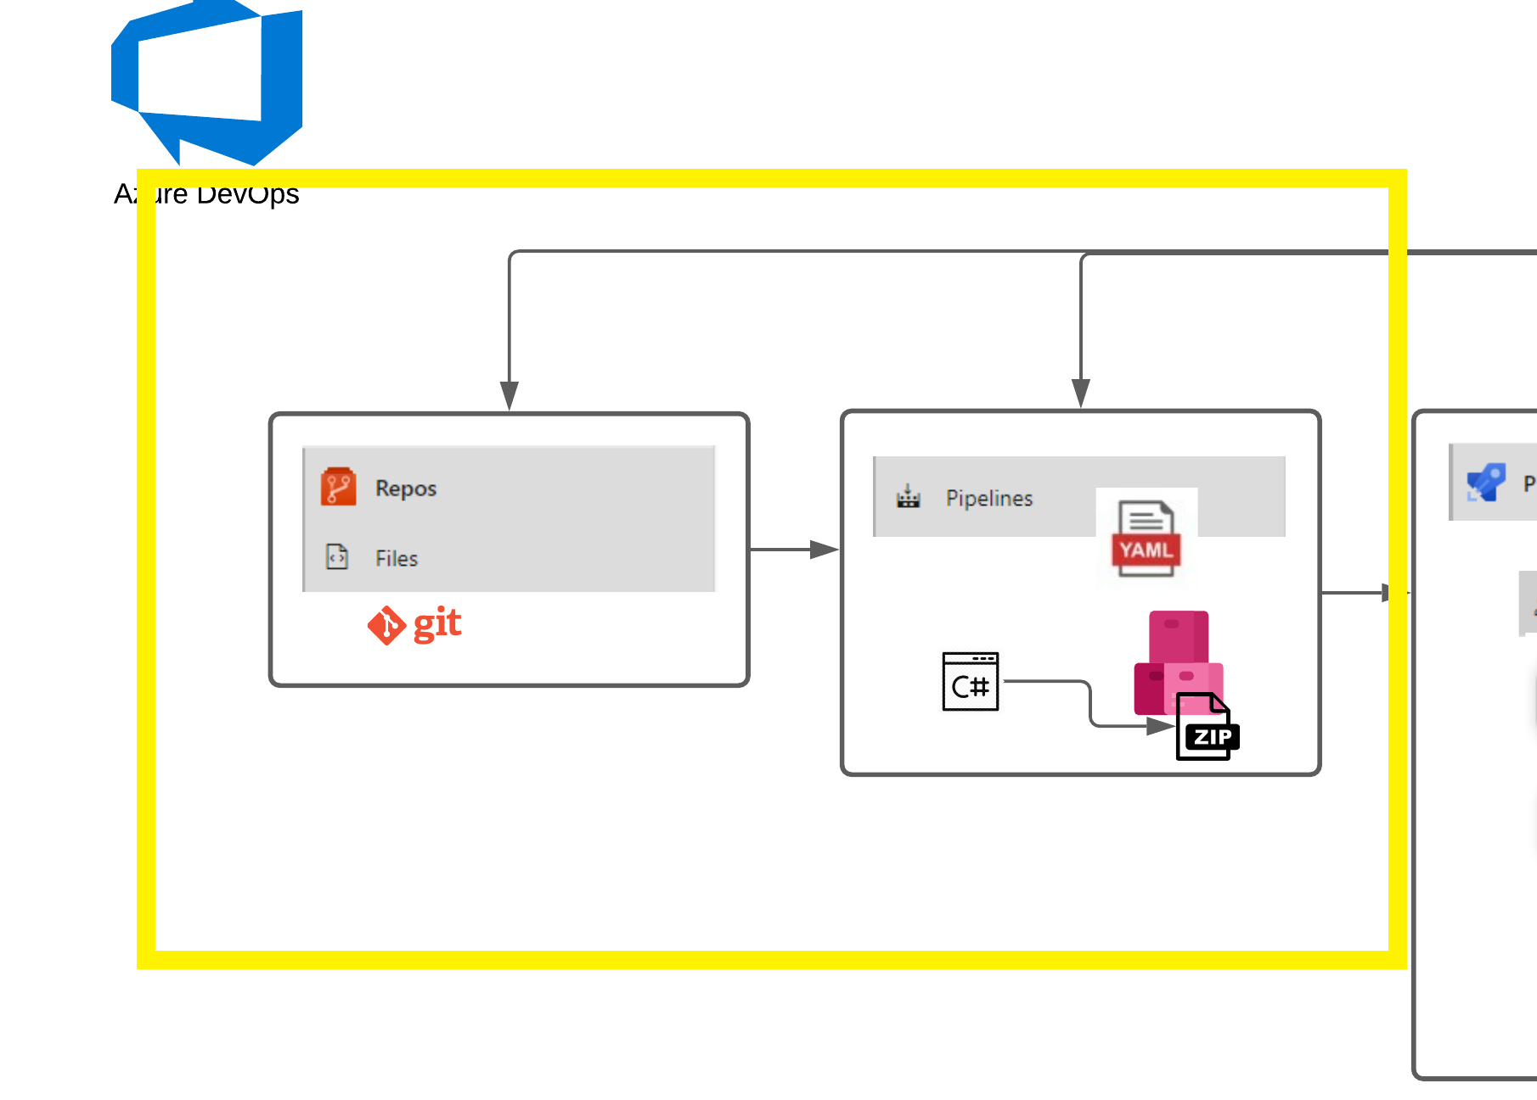
Pipelines - Build
Pipelines
YAML - template
Artifacts

Slide 10
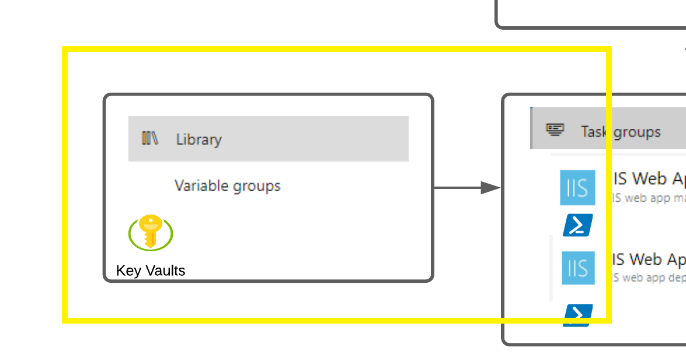
Library
Variable Groups
Azure Key Vaults
Secure Files

Slide 11
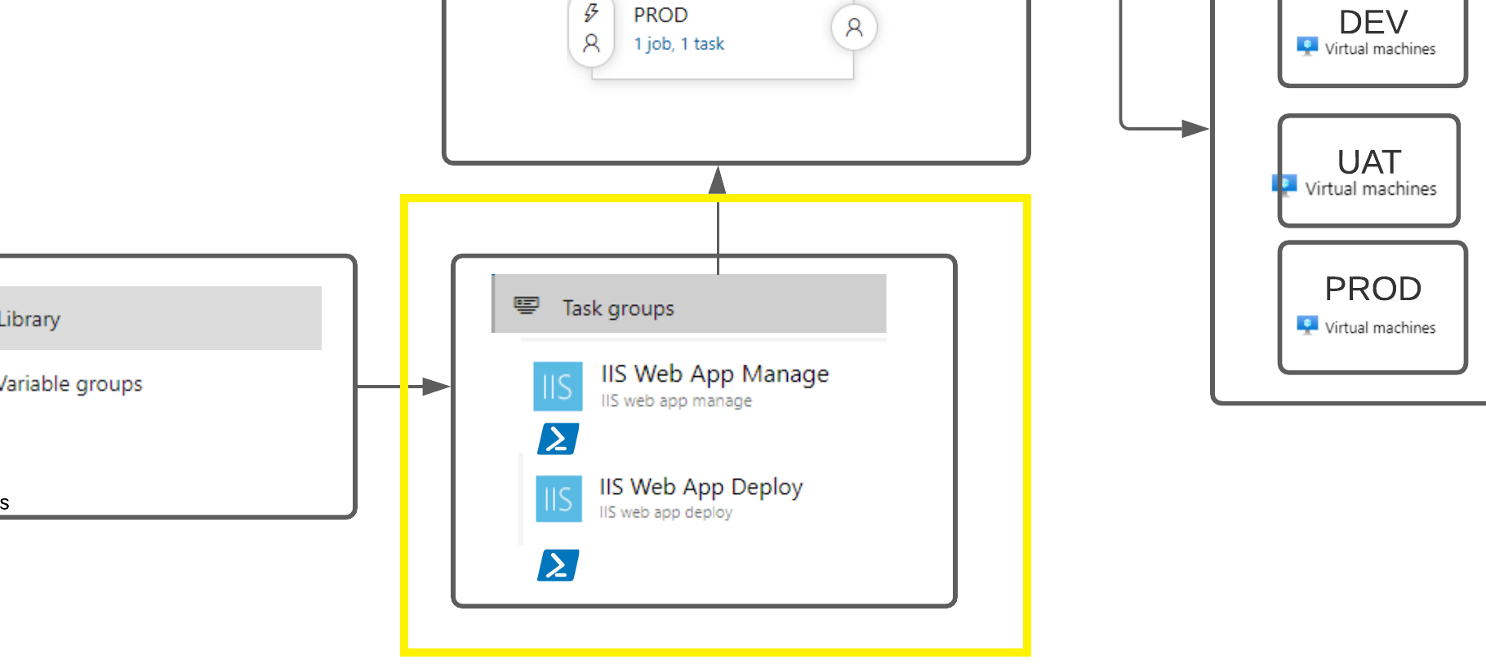
Task Groups
Group tasks into single reusable group
Parameterized for all projects

Slide 12
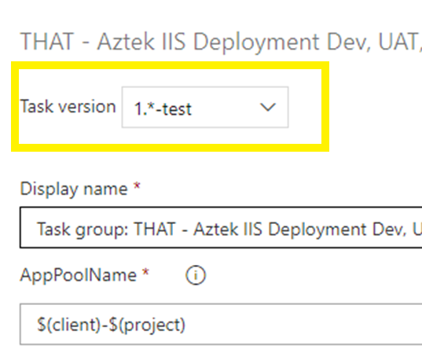
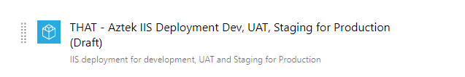
Task Groups - Versions
Drafts
Previews
Task Group Versions
Task Versions

Slide 13
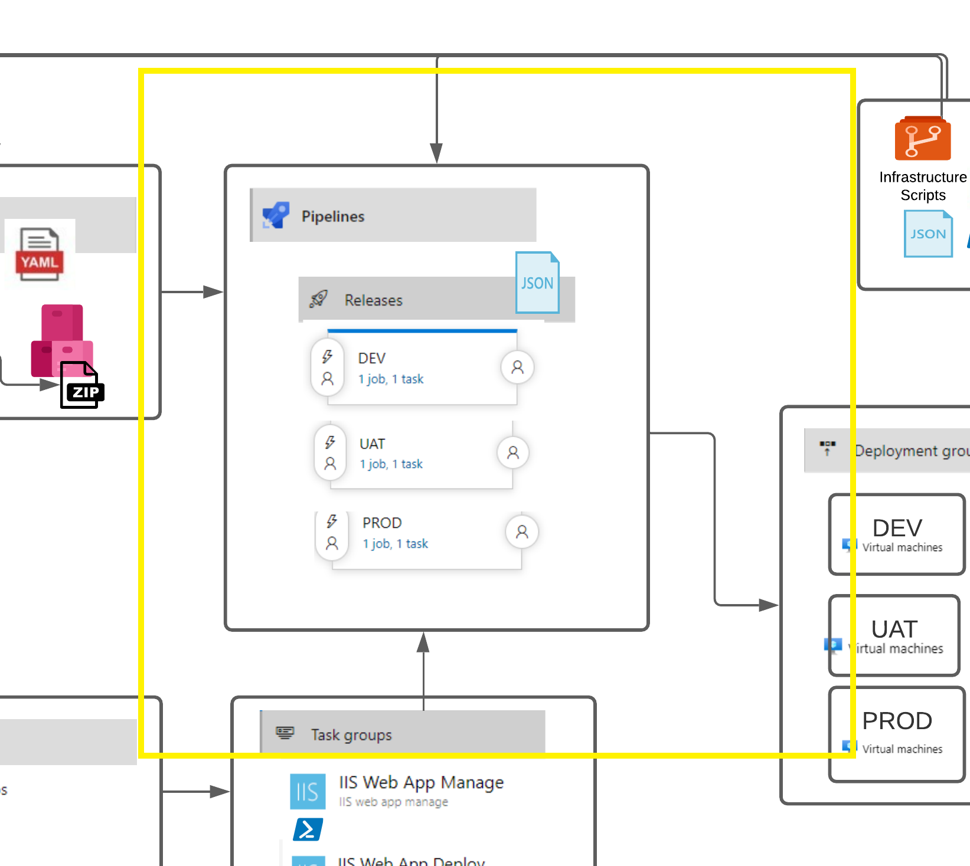
Pipeline - Release
Deploy Apps - Classic
Deploy Apps

Slide 14
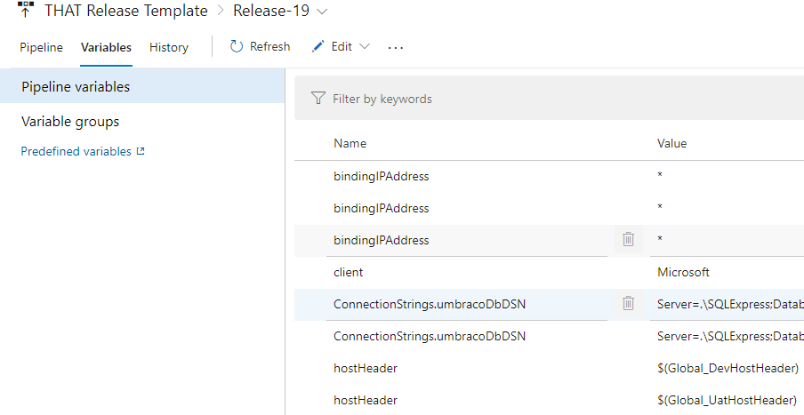
Release Pipeline - Variables
Heart of the configuration – project specific
File system naming
Database naming
Environment URL naming
Logging Settings – DEV, UAT, PROD
Vault for API keys
Connection Strings
Mind your scope!
Secrets

Slide 15
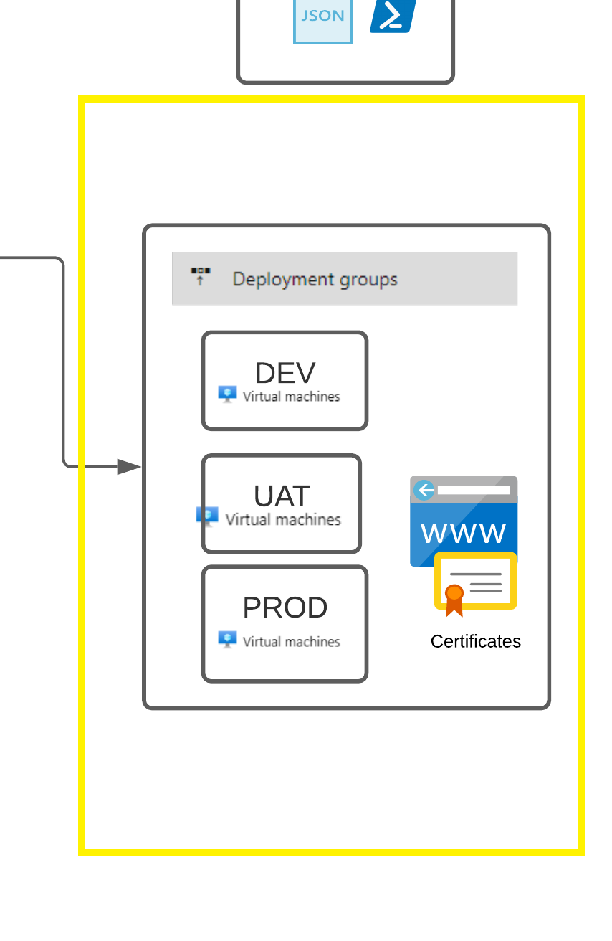
Deployment Groups vs. Environments
Deployment Groups
Target machines with agents installed
Groups represent the physical environments
No YAML
Environments
Can be created in the pipeline
YAML
Better traceability

Slide 16
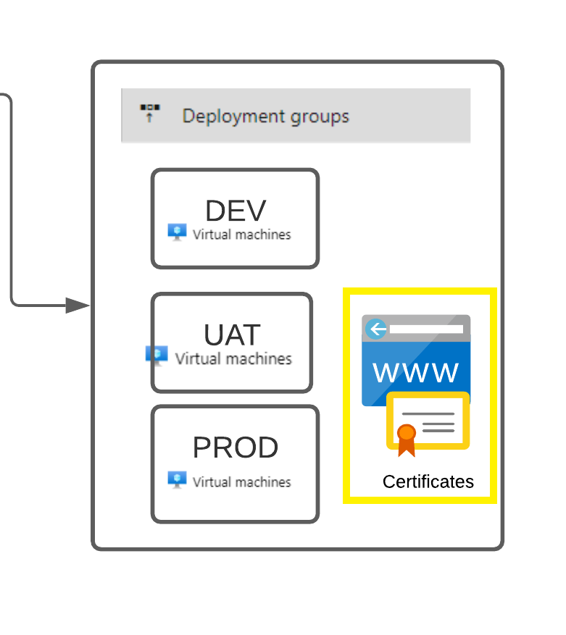
LetsEncrypt
LetsEncrypt Windows Client > WACS – Simple ACME
Supports wildcards
“Plugable” and numerous integrations such as Azure DNS

Slide 17
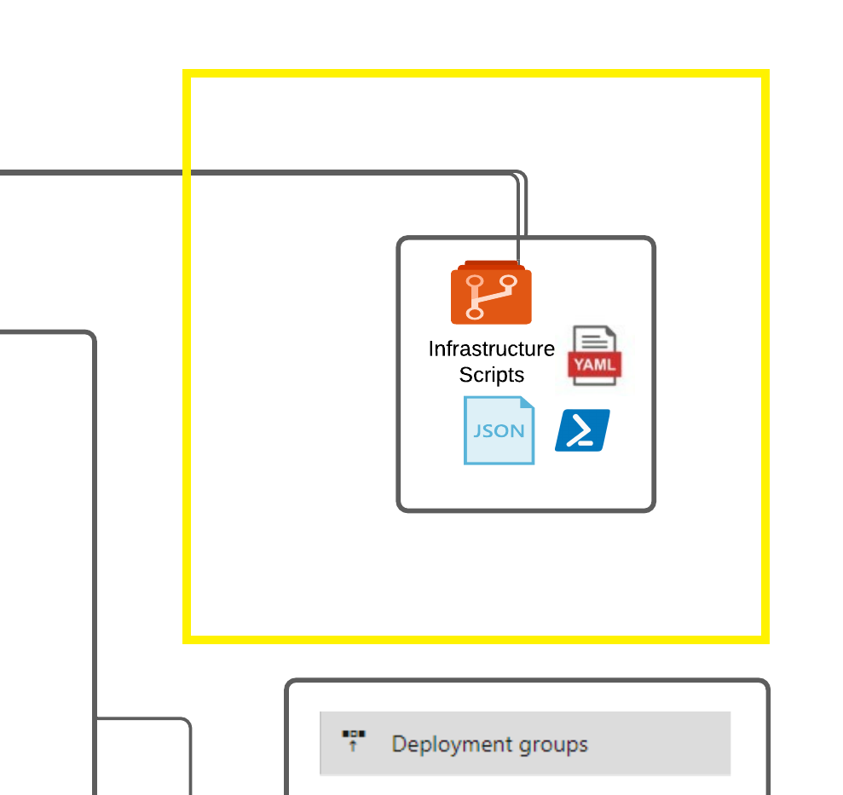
Infrastructure – Script Deployment
Agent Deployment
Separate Release
Build and Release YAML template

Slide 18
End-to-End-Example

Slide 19
Finally…
Let’s Do It Live!!!

Slide 20
Going Forward
Move away from Classic Release to YAML
Production SSL certificates
Removal of bindings for production and proper bindings
.NET 5 improvements
Hardcode specifics based on Stage/Environment for SQL
Pushing up the SQL username to the Release variables
Move to GitHub Actions?

Slide 21
Thank You!
Feedback?
Questions?
Keith A. Rowe
LinkedIn: https://www.linkedin.com/in/keithalanrowe/
Email: krowe@aztekweb.com

Slide 22
Resources
Password generator - https://www.correcthorsebatterystaple.net/
WACS – LetsEncrypt on Windows - https://github.com/win-acme/win-acme

Slide 23


